Slide 1
Contract Monthly Claim System (CMCS)
Final Portfolio of Evidence – Part 3 Automation & Enhancement
Michael Jani
November 2025
ST10451592

Slide 2

Presentation Agenda
Project Evolution: Journey from Part 1 to Part 3.
Feedback Integration: Addressing Part 2 improvements.
System Architecture: Technical stack and design choices.
Part 3 Implementation: Automation, Security, and Database.
Code Walkthrough: Key logic and validation.
Conclusion: Final project summary.

Slide 3
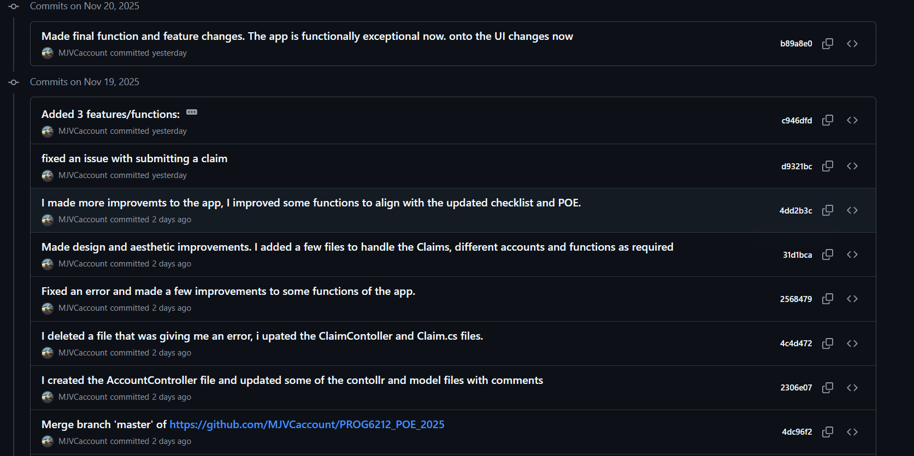
Response to Feedback – Version Control
Lecturer Feedback: "Commits were infrequent (7 total) or lacked clarity."
Improvement Strategy:
Adopted Atomic Commits: Small, focused changes.
Standardized Messages: Used prefixes like Feat:, Fix:, Docs:.
Frequency: Increased to 10+ commits for Part 3 development.
I moved from large, vague commits to a granular history that tracks the exact development lifecycle.

Slide 4
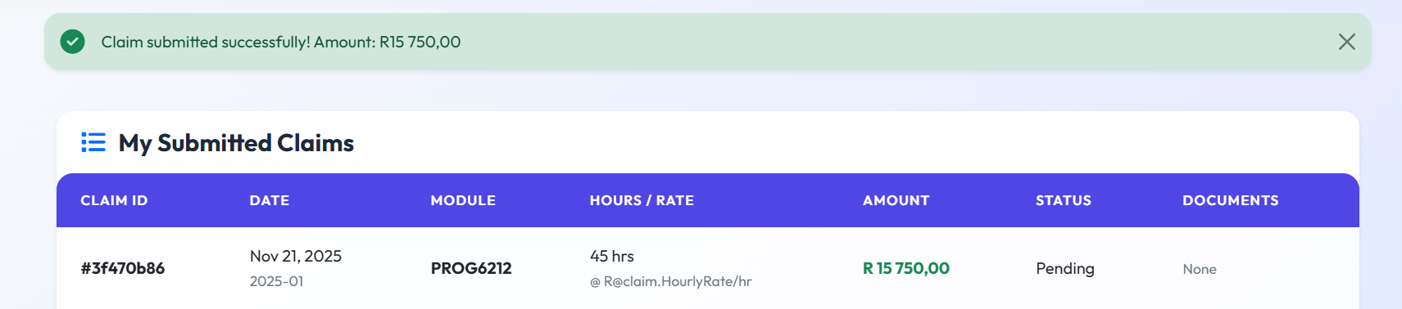
Response to Feedback – Robustness
Lecturer Feedback: "Error handling needs to be robust; Unit testing must cover critical paths."
Improvement Strategy:
Server-Side Validation: Moved logic from UI to C# Services to prevent tampering.
Safety Redirects: implemented [HttpGet] redirects to prevent HTTP 405 crashes.
Feedback Loops: Added TempData alerts for immediate user feedback.

Slide 5
Part 1 recap – Planning & design
Focus: System Analysis & Prototyping.
Key Deliverables:
  UML Class Diagrams: Defining Lecturer, Claim, and Coordinator relationships.
  GUI Prototype: Initial WPF/Console sketches.
  Project Plan: Timeline estimation.

Slide 6
Part 2 recap – Web mvp
Focus: Basic MVC Web Implementation.
Key Features:
  File Uploads (Supporting Documents).
  Basic Claim Submission Form.
  Simple Coordinator Approval View.
Limitation: Data was stored in-memory (Lists), meaning it reset on restart.

Slide 7
Part 3 Overview – Full-Stack Automation
The Goal: Transform the prototype into a production-ready, secure system.
Major Upgrades:
  Database: SQL Server + Entity Framework Core.
  Security: Role-Based Access Control (RBAC) & Encryption.
  Automation: Auto-calculation of claim totals.
  UX: Modern "Glassmorphism" User Interface.

Slide 8
Technical Stack
Framework: ASP.NET Core 8.0 (MVC)
Database: Microsoft SQL Server (LocalDB)
ORM: Entity Framework Core (Code-First Approach)
Security: BCrypt Hashing, Session Management
Frontend: Bootstrap 5 + Custom CSS Variables
Visual: [Logos of .NET, SQL Server, Bootstrap, and C#]

Slide 9
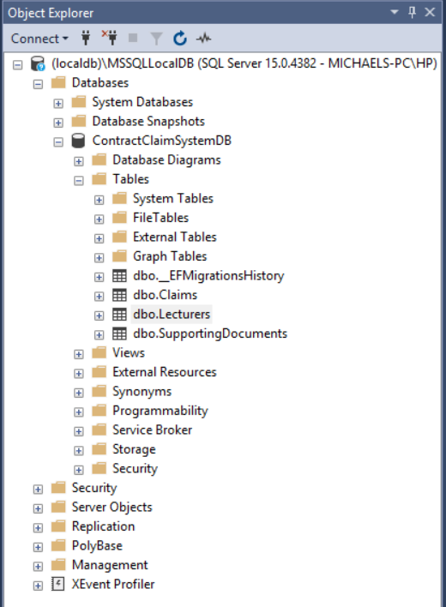
Database Design (Code-First)
Methodology: Defined C# Models first, then generated the schema.
Tables Created:
  Lecturers: Users, Roles, and Hourly Rates.
  Claims: Transaction data linked to Lecturers.
  SupportingDocuments: Encrypted file metadata.
Using Code-First allowed me to keep my application logic and database schema perfectly synced without writing manual SQL scripts.

Slide 10
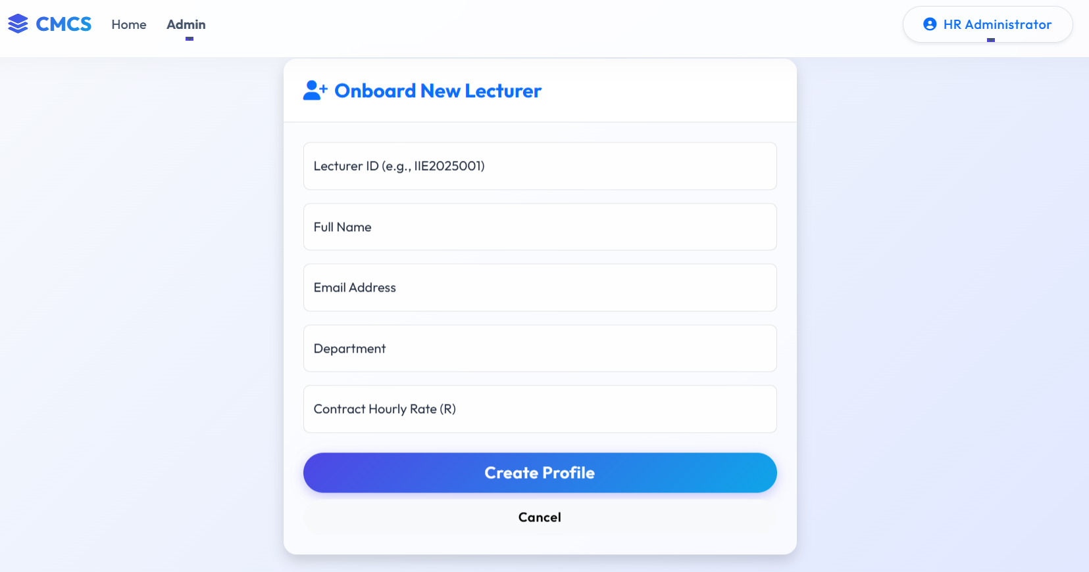
Feature 1 – HR "Super User" Role
Requirement: "HR adds all users... No register button."
Implementation:
Public registration removed to prevent unauthorized access.
HR Dashboard allows onboarding of Lecturers, Coordinators, and Managers.
HR sets the Hourly Rate, locking it from lecturer editing.

Slide 11
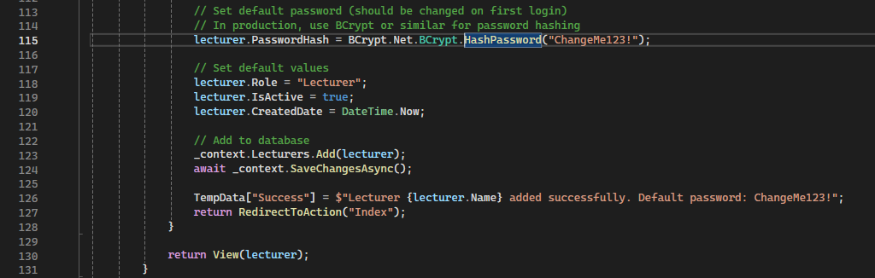
Code Spotlight – Secure Onboarding
Class: HRController.cs
Method: AddLecturer
Logic: * Validates unique ID.
Hashes default password immediately.
Sets IsActive to true.

Slide 12
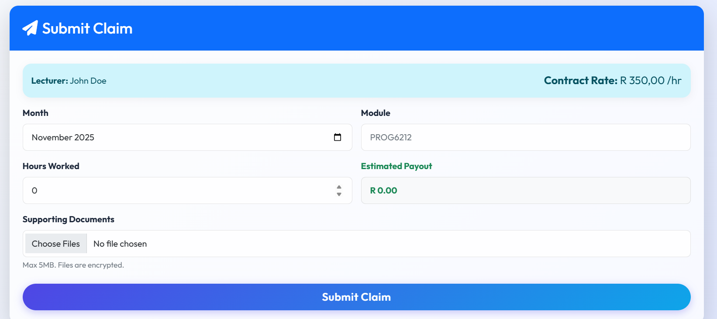
Feature 2 – Centralized Rate Automation
Requirement: "Lecturer should not manually input rate anymore."
Workflow:
Lecturer logs in.
System retrieves their specific rate from the DB.
Rate is displayed as "Read-Only" on the claim form.

Slide 13
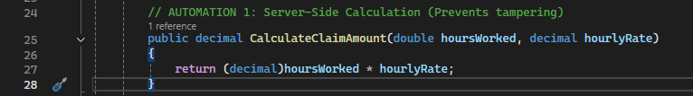
Feature 3 – Automated Calculations
Requirement: "Auto-calculation... input hours worked... show with pulled hourly rate."
Implementation:
  Frontend: JavaScript updates the "Total" field instantly as you type.
  Backend: ClaimAutomationService recalculates Hours * Rate before saving.
Security Note: Backend calculation prevents HTML manipulation attacks.

Slide 14
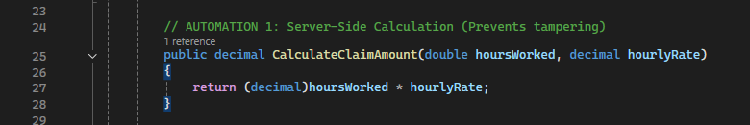
Code Spotlight – Automation Logic
Core Automation: Server-Side Calculation
Ensuring Accuracy and Security
Context: In Part 2, calculations were client-side (JavaScript). In Part 3, this logic was moved to the server to prevent tampering.
Key Takeaways (Bullet points on slide):
  Centralized Logic: One source of truth for all math.
  Security: Prevents "HTML Inspection" attacks where users change the total.
  Accuracy: Handles decimal rounding consistently.
This specific method represents the core of the automation requirement. By moving this math to the server, we ensure that even if a malicious user modifies the HTML to say 'Pay me 1 Million Rand', the server recalculates the true value based on their strict hourly rate before saving.

Slide 15
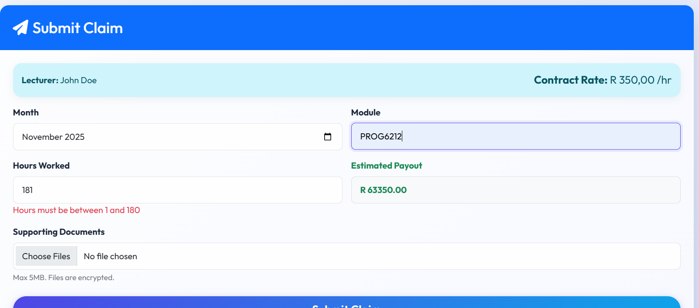
Feature 4 – Business Rule Validation
Requirement: "Validation... if an hourly rate exceeds... 180 hours."
Logic:
Claims > 180 hours are rejected automatically.
Claims with invalid file types (.exe, .bat) are blocked.

Slide 16
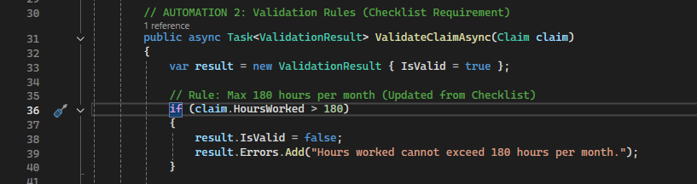
Code Spotlight – Validation Service
Class: ClaimAutomationService.cs
Method: ValidateClaimAsync
By extracting this logic into a service, I made the system modular and easier to unit test.

Slide 17
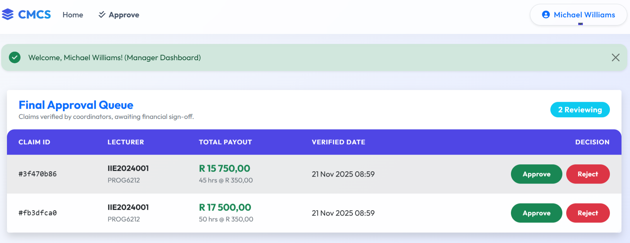
Feature 5 – Approval Workflows
Requirement: Separate views for Coordinator and Manager.
Flow:
  Lecturer submits (Status: Pending).
  Coordinator verifies (Status: Verified).
  Manager approves (Status: Approved).

Slide 18
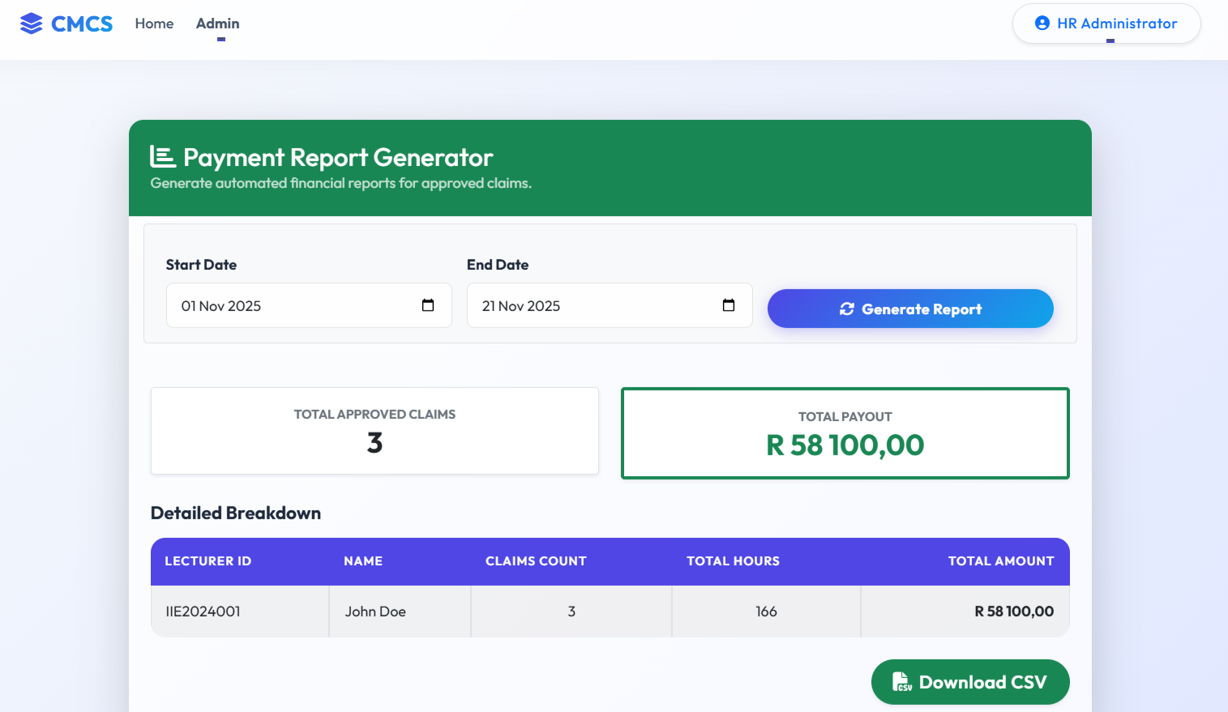
Feature 6 – Reporting & Analytics
Requirement: "HR can generate reports... can use LINQ."
Implementation:
  LINQ query groups claims by Lecturer.
  Sums total payout and hours.
  Exports data for financial processing.

Slide 19
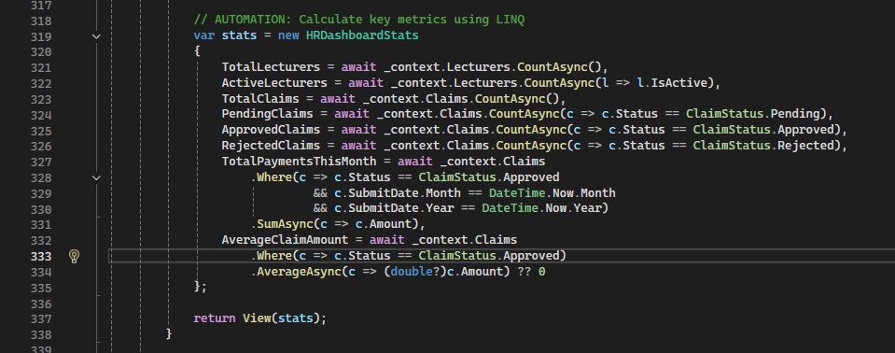
Code Spotlight – LINQ Reporting
Analytics Engine: LINQ Reporting
Generating Business Intelligence from Raw Data
Context: HR requires aggregated views of lecturer performance and financial liability.
Key Takeaways:
  Efficiency: Database does the heavy lifting (filtering & grouping).
  Clarity: Transforms raw rows into a meaningful financial summary.
  Scalability: Works efficiently even with thousands of claims.
This code snippet demonstrates the power of LINQ. Instead of loading every single claim into memory and looping through them—which is slow—we construct a query that asks the database to 'Group by Lecturer' and 'Sum the Amounts'. This is efficient, scalable, and meets the specific LINQ requirement in the checklist.

Slide 20
Conclusion
Summary: The CMCS is now a secure, full-stack .NET application.
Key Achievements:
  Fully automated math and validation.
  Secure, centralized user management.
  Modern, responsive "Glassmorphism" User Interface.
  Robust SQL Database backend.
Thank You

